Slide 1
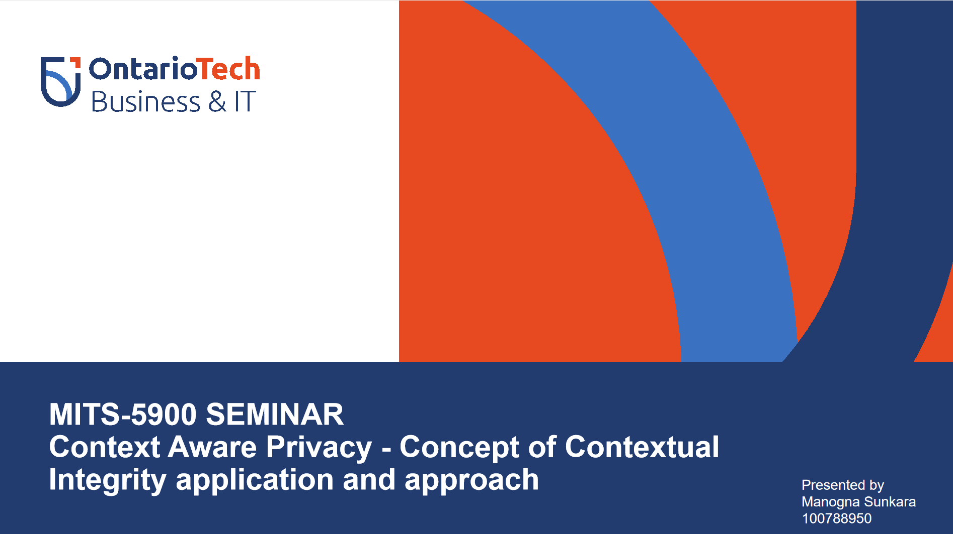

Slide 2
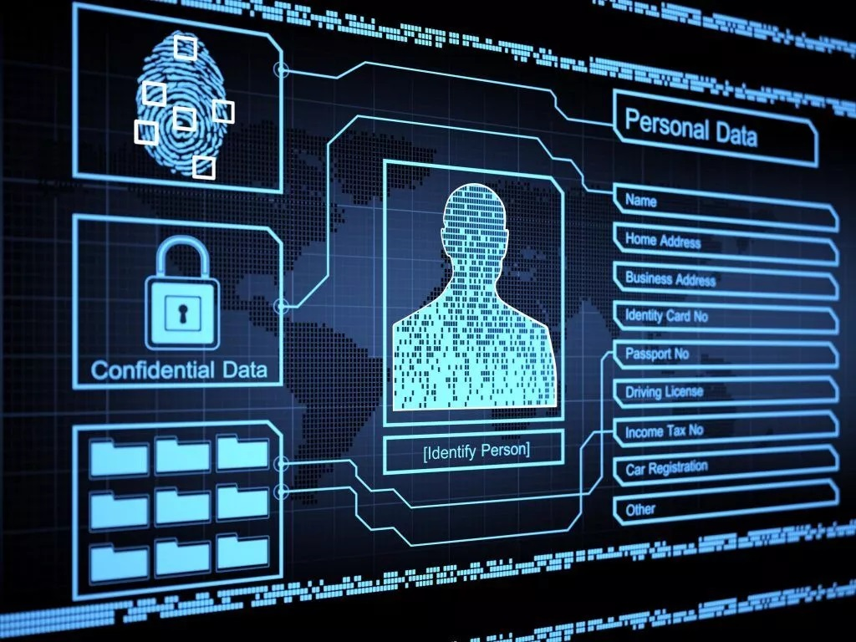
Contextual Integrity
Protecting privacy against data breaches and misuse
Notes:
https://unsplash.com/photos/AXu2aZ3YgP8

Slide 3

Introduction

Slide 4
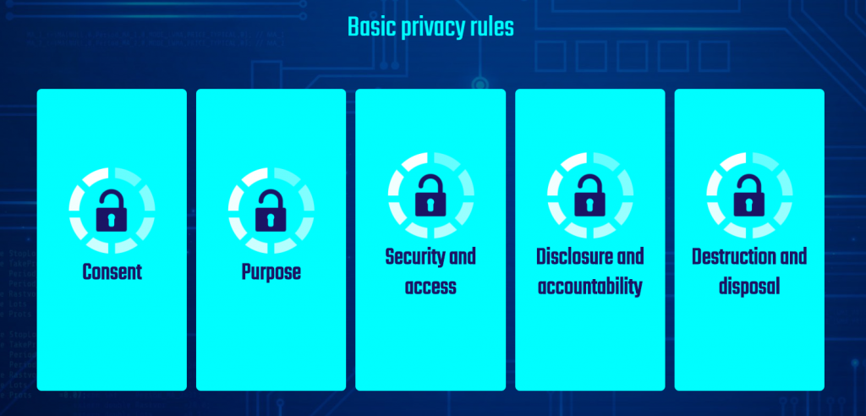
Introduction
Enforcement of privacy policies
Legal and ethical dimensions
Need for Privacy preserving frameworks
Accountability and Trust
Holding and sharing the personal information for completing the tasks
Notes:
https://unsplash.com/photos/fItRJ7AHak8

Slide 5
Introduction
Why privacy?
Enormous amounts of personal data sharing
Digital Intrusions
Example Cases - Facebook Analytic Candle, Google cookies scandal etc.
Question : Will organizations adopt privacy requirements expectations while pursuing their goals?
Notes:
https://unsplash.com/photos/fItRJ7AHak8

Slide 6
Contextual Integrity

Slide 7

Contextual Integrity
Background and Related work
“Contextual integrity is a theory of information privacy which argues that social relations are guided by norms in information flows and that privacy is violated when these norms are violated.” - (Nissenbaum, 2004)
Meaningful account of privacy - limiting use, storing and destruction
“True” definition of the concept
Ethically and legally legitimate to defend Technology
Notes:
https://unsplash.com/photos/fItRJ7AHak8

Slide 8

Contextual Integrity
Background and Related Works
Central concept : Context
Conceptions : Secrecy and leakage, Conform with norms and rules, Legitimate worth defending
Appropriateness and Norms of flow
Related works - Conceptual approach to Information Privacy research (Recognizing “transparency and choice”)
Notes:
https://unsplash.com/photos/fItRJ7AHak8

Slide 9

Solution

Slide 10
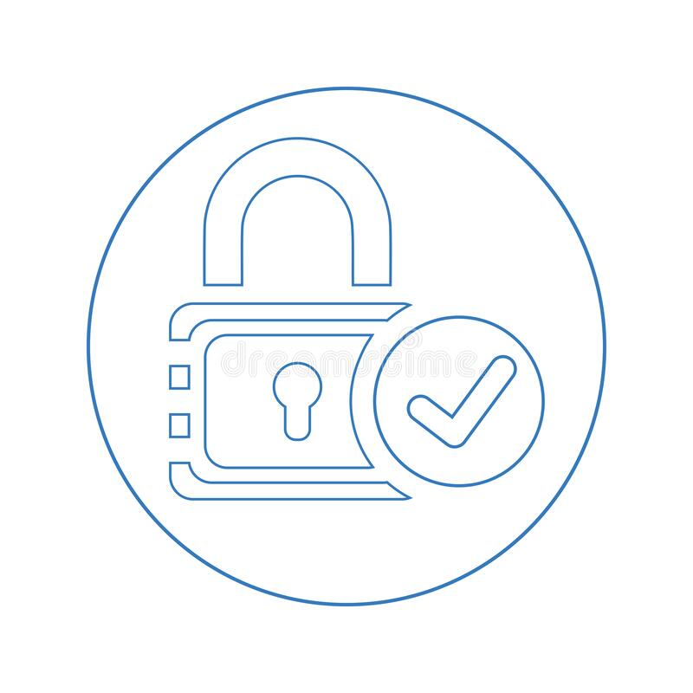

Solution
Legal and ethical dimensions
Contextual approach to privacy - Retaining privacy and security hand in hand
Contexts :
Privacy in network contexts
Privacy in Global Regulatory context
Expression and enforcement of privacy policies and laws binding it
Notes:
https://unsplash.com/photos/48nerZQCHgo

Slide 11
Solution
Business model
Encrypting everything
Question : How do we locate the data and verification
Decryption locally?
Question: Performance issues involved
Solution : Encrypt data such that the server can return the encrypted data with minimal contents in the data!!
Notes:
https://unsplash.com/photos/48nerZQCHgo

Slide 12

MODEL IDEA

Slide 13


MODEL IDEA
Idea : Encryption and Decryption of data
client side encryption
Server side storage
Organization with holding the information
Access control and user privileges
Notes:
https://unsplash.com/photos/TvN54bnuQg8

Slide 14
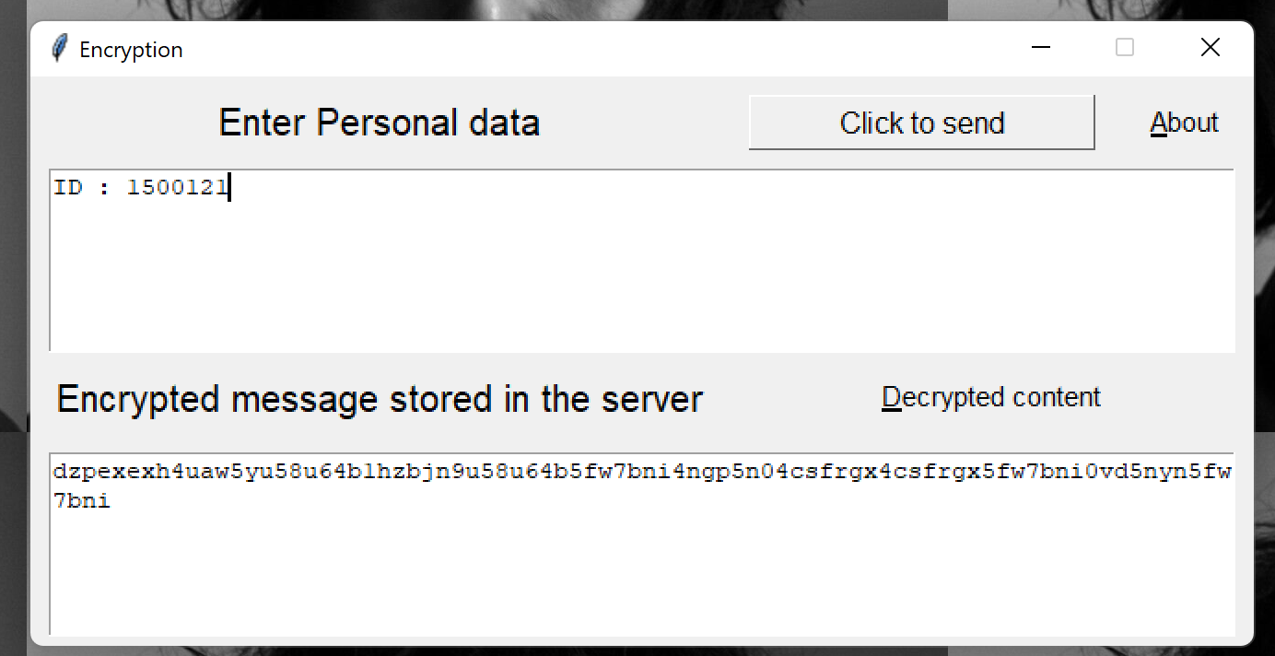
SAMPLE MODEL RESULTS
Notes:
https://unsplash.com/photos/TvN54bnuQg8

Slide 15
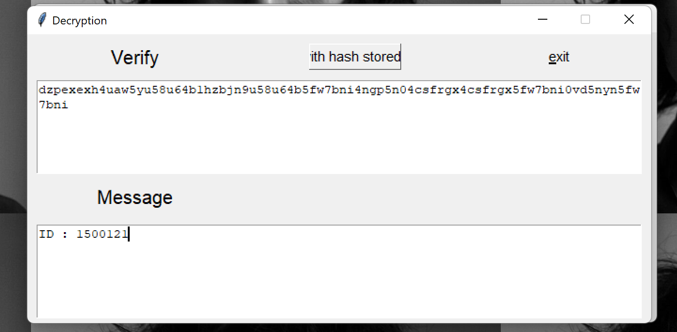
MODEL RESULTS
Notes:
https://unsplash.com/photos/TvN54bnuQg8

Slide 16

PROPOSED
MODEL

Slide 17


PROPOSED
MODEL
Using above model encryption and decryption we propose a business model to store encrypted messages in the server and retrieve the data with minimal content.
User fills the sensitive date
The data is encrypted and stored in the server (cipher text)
Permission for data retrial : OTP/ verification using hash code
Notes:
https://unsplash.com/photos/GKLIsLZxhj0

Slide 18
PROPOSED
MODEL
VERIFICATION/ SERVER SEARCH :
Given that it has decrypt ed the IDs and is aware of which have been requested, the server has the option of returning messages that are encrypted.
The way our system is currently being used. Alternatively, the server might return a list of IDs and the client could send a second request for the messages themselves.
Notes:
https://unsplash.com/photos/GKLIsLZxhj0

Slide 19
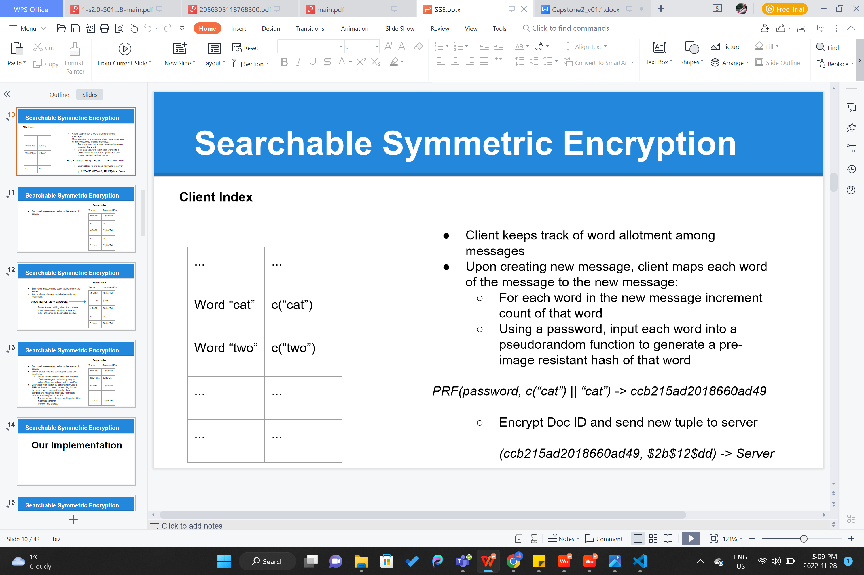
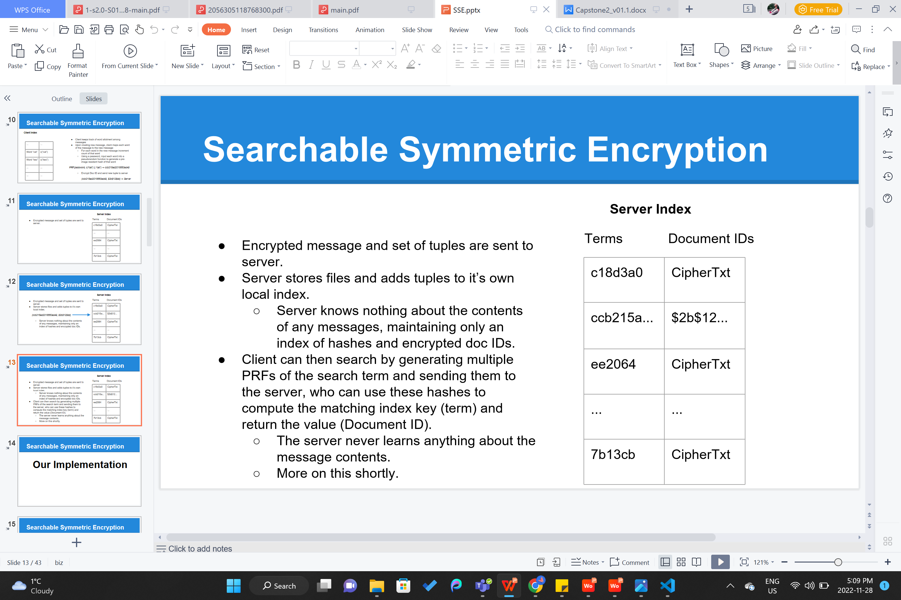
PROPOSED
MODEL
Using tuple mapping we can search, update information and store the sensitive information with minimal details of the client.
Notes:
https://unsplash.com/photos/GKLIsLZxhj0

Slide 20
CONCLUSION

Slide 21
conclusion
Providing service with “Respect to privacy”
Regulatory norms and ethics
Model application for preserving the sensitive data using encryption and decrytion
Achieving privacy and accountability
Reduces the risk of data breaches and misuage of data
Future Scope :
Developing the server side program to implemention proposed model
Using advance encrytion and hashing techniques for data transfer and storage
Advance Access controls for accountability of data

Slide 22
THANK YOU

Slide 23
QUESTIONS?

Slide 24
REFERENCES:
Bulmer, J. H., Faily, S., &amp; Jeary, S. (n.d.). Privacy risk assessment in context: A meta-model based on contextual integrity.
Wu, P.F., Vitak, J. and Zimmer, M.T. (2020), A contextual approach to information privacy research. Journal of the Association for Information Science and Technology, 71: 485-490. https://doi.org/10.1002/asi.24232
Helen Nissenbaum, Symposium, Privacy as Contextual Integrity, 79 Wash. L. Rev. 119 (2004).
Available at: https://digitalcommons.law.uw.edu/wlr/vol79/iss1/10
A. Barth, A. Datta, J. C. Mitchell and H. Nissenbaum, "Privacy and contextual integrity: framework and applications," 2006 IEEE Symposium on Security and Privacy (S&P'06), 2006, pp. 15 pp.-198, doi: 10.1109/SP.2006.32.
Ashley, P., Hada, S., Karjoth, G., Powers, C., Schunter, M.: Enterprise Privacy Authorization Language (EPAL). Research Report 3485, IBM Research (2003)
Backes, M., Dürmuth, M., Steinwandt, R.: An algebra for composing enterprise privacy policies. Research Report 3557, IBM Research (2004)
Zimmer, M. (2018). Addressing Conceptual Gaps in Big Data Research Ethics: An Application of Contextual Integrity. Social Media + Society. https://doi.org/10.1177/2056305118768300

